Slide 1
Introduction to Transaction Processing Concepts and Theory
Copyright © 2007 Ramez Elmasri and Shamkant B. Navathe

Slide 2
Chapter Outline
1 Introduction to Transaction Processing
2 Transaction and System Concepts
3 Desirable Properties of Transactions
4 Characterizing Schedules based on Recoverability
5 Characterizing Schedules based on Serializability
6 Transaction Support in SQL
Slide 17- <number>

Slide 3
1 Introduction to Transaction Processing (1)
Transaction processing systems are systems with large databases and hundreds of concurrent users executing database transactions.
Examples of such systems include airline reservations, banking, credit card processing, online retail purchasing, stock markets etc…
These systems require high availability and fast response time for hundreds of concurrent users.
In this chapter we present the concepts that are needed in transaction processing systems.
We define the concept of a transaction, which is used to represent a logical unit of database processing that must be completed in its entirety to ensure correctness.
Slide 17- <number>

Slide 4
1 Introduction to Transaction Processing (1)
Single-User System:
  At most one user at a time can use the system.
Multiuser System:
  Many users can access the system concurrently.
Concurrency
  Interleaved processing:
    Concurrent execution of processes is interleaved in a single CPU
  Parallel processing:
    Processes are concurrently executed in multiple CPUs.
Slide 17- <number>

Slide 5
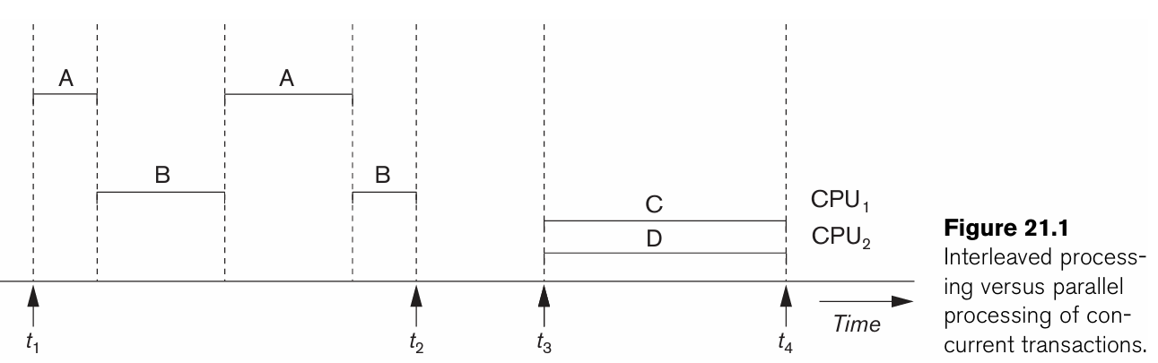
Slide 17- <number>

Slide 6
Introduction to Transaction Processing (2)
A Transaction:
  Logical unit of database processing that includes one or more access operations (read -retrieval, write - insert or update, delete).
A transaction (set of operations) may be stand-alone specified in a high level language like SQL submitted interactively, or may be embedded within a program.
Transaction boundaries:
  One way of specifying the transaction boundaries is by specifying explicit begin transaction and end transaction statements in an application program.
An application program may contain several transactions separated by the Begin and End transaction boundaries.
If the database operations in a transaction do not update the database but only retrieve data, the transaction is called a read-only transaction; otherwise it is known as a read-write transaction.
Slide 17- <number>

Slide 7
Introduction to Transaction Processing (3)
SIMPLE MODEL OF A DATABASE (for purposes of discussing transactions):
A database is a collection of named data items
The size of the data items is called as Granularity of data - a field, a record , or a whole disk block (Concepts are independent of granularity)
Basic operations are read and write
  read_item(X): Reads a database item named X into a program variable. To simplify our notation, we assume that the program variable is also named X.
  write_item(X): Writes the value of program variable X into the database item named X.
Slide 17- <number>

Slide 8
Introduction to Transaction Processing (4)
READ AND WRITE OPERATIONS:
Basic unit of data transfer from the disk to the computer main memory is one block.
In general, a data item (what is read or written) will be the field of some record in the database, although it may be a larger unit such as a record or even a whole block.
read_item(X) command includes the following steps:
  Find the address of the disk block that contains item X.
  Copy that disk block into a buffer in main memory (if that disk block is not already in some main memory buffer).
  Copy item X from the buffer to the program variable named X.
Slide 17- <number>

Slide 9
Introduction to Transaction Processing (5)
READ AND WRITE OPERATIONS (contd.):
write_item(X) command includes the following steps:
  Find the address of the disk block that contains item X.
  Copy that disk block into a buffer in main memory (if that disk block is not already in some main memory buffer).
  Copy item X from the program variable named X into its correct location in the buffer.
  Store the updated block from the buffer back to disk (either immediately or at some later point in time).
The DBMS will maintain in the database cache a number of data buffers in main memory.
Each buffer typically holds the contents of one database disk block, which contains some of the database items being processed.
Slide 17- <number>

Slide 10

Two sample transactions
Two sample transactions:
  The read-set of a transaction is the set of all items that the transaction reads, and the write-set is the set of all items that the transaction writes.
  For example, the read-set of T1 in Figure 21.2 is {X, Y} and its write-set is also {X, Y}.
Slide 17- <number>

Slide 11
Introduction to Transaction Processing (6)
Why Concurrency Control is needed:
The Lost Update Problem
  This occurs when two transactions that access the same database items have their operations interleaved in a way that makes the value of some database item incorrect.
The Temporary Update (or Dirty Read) Problem
  This occurs when one transaction updates a database item and then the transaction fails for some reason.
  The updated item is accessed by another transaction before it is changed back to its original value.
The Incorrect Summary Problem
  If one transaction is calculating an aggregate summary function on a number of records while other transactions are updating some of these records, the aggregate function may calculate some values before they are updated and others after they are updated.
Slide 17- <number>

Slide 12
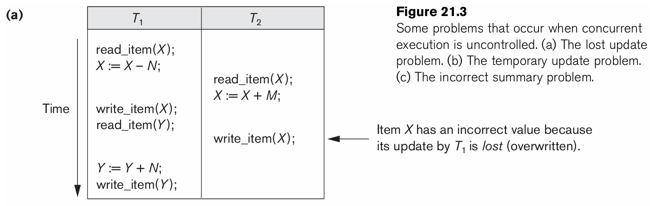
Concurrent execution is uncontrolled: (a) The lost update problem.
A transaction T1 that transfers N reservations from one flight whose number of reserved seats is stored in the database item named X to another flight whose number of reserved seats is stored in the database item named Y.
Slide 17- <number>

Slide 13
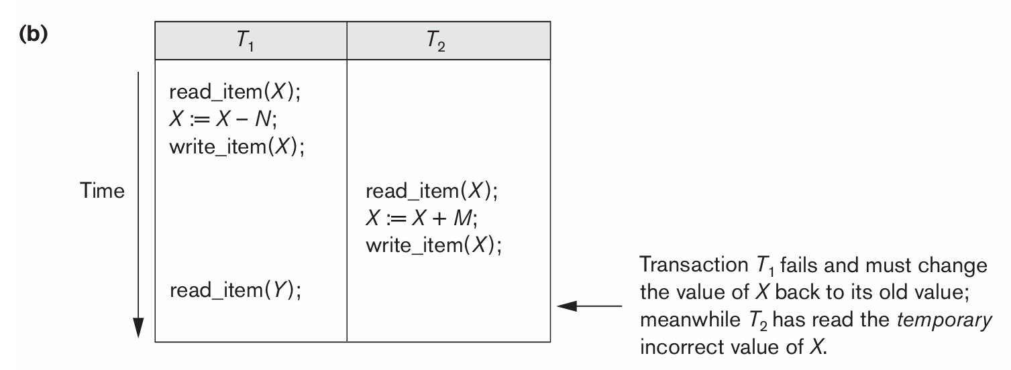
Concurrent execution is uncontrolled: (b) The temporary update problem.
Slide 17- <number>

Slide 14
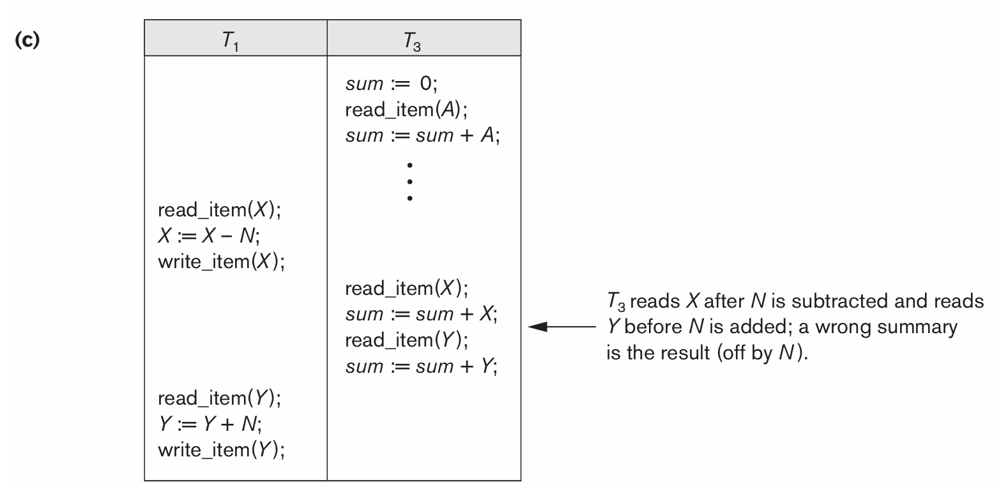
Concurrent execution is uncontrolled: (c) The incorrect summary problem.
Slide 17- <number>

Slide 15
The Unrepeatable Read Problem
Another problem that may occur is called unrepeatable read, where a transaction T reads the same item twice and the item is changed by another transaction T between the two reads.
Hence, T receives different values for its two reads of the same item.
This may occur, for example, if during an airline reservation transaction, a customer inquires about seat availability on several flights. When the customer decides on a particular flight, the transaction then reads the number of seats on that flight a second time before completing the reservation, and it may end up reading a different value for the item.
Slide 17- <number>

Slide 16
Introduction to Transaction Processing (12)
Why recovery is needed:
Failures are generally classified as transaction, system, and media failures. There are several possible reasons for a transaction to fail in the middle of execution:
1. A computer failure (system crash):
    A hardware or software error occurs in the computer system during transaction execution. If the hardware crashes, the contents of the computer’s internal memory may be lost.
  2. A transaction or system error:
    Some operation in the transaction may cause it to fail, such as integer overflow or division by zero. Transaction failure may also occur because of erroneous parameter values or because of a logical programming error. In addition, the user may interrupt the transaction during its execution.
Slide 17- <number>

Slide 17
Introduction to Transaction Processing (13)
Why recovery is needed (Contd.):
(What causes a Transaction to fail)
  3. Local errors or exception conditions detected by the transaction:
    Certain conditions necessitate cancellation of the transaction. For example, data for the transaction may not be found. A condition, such as insufficient account balance in a banking database, may cause a transaction, such as a fund withdrawal from that account, to be canceled.
    A programmed abort in the transaction causes it to fail.
  4. Concurrency control enforcement:
    The concurrency control method may decide to abort the transaction, to be restarted later, because it violates serializability or because several transactions are in a state of deadlock.
Slide 17- <number>

Slide 18
Introduction to Transaction Processing (14)
Why recovery is needed (contd.):
(What causes a Transaction to fail)
  5. Disk failure:
    Some disk blocks may lose their data because of a read or write malfunction or because of a disk read/write head crash. This may happen during a read or a write operation of the transaction.
  6. Physical problems and catastrophes:
    This refers to an endless list of problems that includes power or air-conditioning failure, fire, theft, sabotage, overwriting disks or tapes by mistake, and mounting of a wrong tape by the operator.
Slide 17- <number>

Slide 19
2 Transaction and System Concepts (1)
A transaction is an atomic unit of work that is either completed in its entirety or not done at all.
  For recovery purposes, the system needs to keep track of when the transaction starts, terminates, and commits or aborts.
Transaction states:
  Active state
  Partially committed state
  Committed state
  Failed state
  Terminated State
Slide 17- <number>

Slide 20
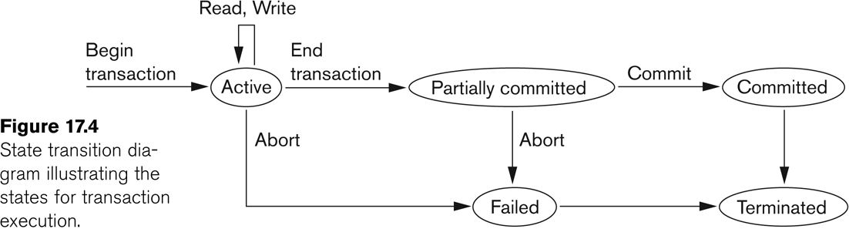
State transition diagram illustrating the states for transaction execution
Slide 17- <number>

Slide 21
Transaction and System Concepts (2)
Recovery manager keeps track of the following operations:
  begin_transaction: This marks the beginning of transaction execution.
  read or write: These specify read or write operations on the database items that are executed as part of a transaction.
  end_transaction: This specifies that read and write transaction operations have ended and marks the end limit of transaction execution.
    At this point it may be necessary to check whether the changes introduced by the transaction can be permanently applied to the database or whether the transaction has to be aborted because it violates concurrency control or for some other reason.
Slide 17- <number>

Slide 22
Transaction and System Concepts (3)
Recovery manager keeps track of the following operations (cont):
  commit_transaction: This signals a successful end of the transaction so that any changes (updates) executed by the transaction can be safely committed to the database and will not be undone.
  rollback (or abort): This signals that the transaction has ended unsuccessfully, so that any changes or effects that the transaction may have applied to the database must be undone.
Slide 17- <number>

Slide 23
Transaction and System Concepts (4)
Recovery techniques use the following operators:
  undo: Similar to rollback except that it applies to a single operation rather than to a whole transaction.
  redo: This specifies that certain transaction operations must be redone to ensure that all the operations of a committed transaction have been applied successfully to the database.
Slide 17- <number>

Slide 24
Transaction and System Concepts (6)
The System Log
  Log or Journal: The log keeps track of all transaction operations that affect the values of database items.
    This information may be needed to permit recovery from transaction failures.
    The log is kept on disk, so it is not affected by any type of failure except for disk or catastrophic failure.
    In addition, the log is periodically backed up to archival storage (tape) to guard against such catastrophic failures.
Slide 17- <number>

Slide 25
Transaction and System Concepts (7)
The System Log (cont):
  T in the following discussion refers to a unique transaction-id that is generated automatically by the system and is used to identify each transaction:
  Types of log record:
    [start_transaction,T]: Records that transaction T has started execution.
    [write_item,T,X,old_value,new_value]: Records that transaction T has changed the value of database item X from old_value to new_value.
    [read_item,T,X]: Records that transaction T has read the value of database item X.
    [commit,T]: Records that transaction T has completed successfully, and affirms that its effect can be committed (recorded permanently) to the database.
    [abort,T]: Records that transaction T has been aborted.
Slide 17- <number>

Slide 26
Transaction and System Concepts (8)
The System Log (cont):
  Protocols for recovery that avoid cascading rollbacks do not require that read operations be written to the system log, whereas other protocols require these entries for recovery.
  some recovery protocols require simpler WRITE entries only include one of new_value and old_value instead of including both
Slide 17- <number>

Slide 27
Transaction and System Concepts (9)
Recovery using log records:
If the system crashes, we can recover to a consistent database state by examining the log and using one of the techniques:
  Because the log contains a record of every write operation that changes the value of some database item, it is possible to undo the effect of these write operations of a transaction T by tracing backward through the log and resetting all items changed by a write operation of T to their old_values.
  We can also redo the effect of the write operations of a transaction T by tracing forward through the log and setting all items changed by a write operation of T (that did not get done permanently) to their new_values.
Slide 17- <number>

Slide 28
Transaction and System Concepts (10)
Commit Point of a Transaction:
Definition a Commit Point:
  A transaction T reaches its commit point when all its operations that access the database have been executed successfully and the effect of all the transaction operations on the database has been recorded in the log.
  Beyond the commit point, the transaction is said to be committed, and its effect is assumed to be permanently recorded in the database.
  The transaction then writes an entry [commit,T] into the log.
Roll Back of transactions:
  Needed for transactions that have a [start_transaction,T] entry into the log but no commit entry [commit,T] into the log. these transactions may have to be rolled back to undo their effect on the database during the recovery process
Slide 17- <number>

Slide 29
Transaction and System Concepts (11)
Commit Point of a Transaction (cont):
Redoing transactions:
  Transactions that have written their commit entry in the log must also have recorded all their write operations in the log; otherwise, they would not be committed, so their effect on the database can be redone from the log entries. (Notice that the log file must be kept on disk. At the time of a system crash, only the log entries that have been written back to disk are considered in the recovery process because the contents of main memory may be lost.)
Force writing a log:
  Before a transaction reaches its commit point, any portion of the log that has not been written to the disk yet must now be written to the disk.
  This process is called force-writing the log file before committing a transaction.
Slide 17- <number>

Slide 30
3 Desirable Properties of Transactions (1)
ACID properties:
Atomicity: A transaction is an atomic unit of processing; it is either performed in its entirety or not performed at all.
Consistency preservation: A correct execution of the transaction must take the database from one consistent state to another.
Isolation: A transaction should not make its updates visible to other transactions until it is committed; this property, when enforced strictly, solves the temporary update problem and makes cascading rollbacks of transactions unnecessary
Durability or permanency: Once a transaction changes the database and the changes are committed, these changes must never be lost because of subsequent failure.
Slide 17- <number>

Slide 31
Schedules (Histories) of Transactions
When transactions are executing concurrently in an interleaved fashion, then the order of execution of operations from all the various transactions is known as a schedule (or history)
A schedule (or history) S of n transactions T1, T2,...,Tn is an ordering of the operations of the transactions.
Operations from different transactions can be interleaved in the schedule S.
However, for each transaction Ti that participates in the schedule S, the operations of Ti in S must appear in the same order in which they occur in Ti .
Slide 17- <number>

Slide 32
A shorthand notation for describing a schedule uses the symbols b, r, w, e, c, and a for the operations begin_transaction, read_item, write_item, end_transaction, commit, and abort, respectively, and appends as a subscript the transaction id (transaction number) to each operation in the schedule.
In this notation, the data base item X that is read or written follows the r and w operations in parentheses.
Slide 17- <number>

Slide 33
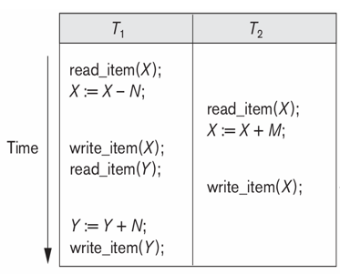
In the following which we shall call Sa, can be written as follows in this notation:
Sa: r1(X); r2(X); w1(X); r1(Y); w2(X); w1(Y);
Slide 17- <number>

Slide 34
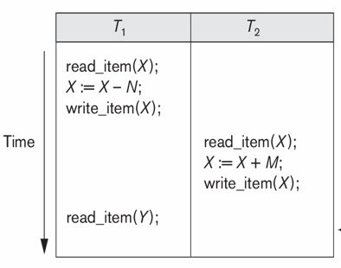
If we assume that transaction T1 aborted after its read_item(Y) operation
Sb: r1(X); w1(X); r2(X); w2(X); r1(Y); a1;
Slide 17- <number>

Slide 35
Two operations in a schedule are said to conflict if they satisfy all three of the following conditions:
(1) they belong to different transactions;
(2) they access the same item X; and
(3) at least one of the operations is a write_item(X).
Slide 17- <number>

Slide 36
For example, in schedule Sa, the operations r1(X) and w2(X) conflict, as do the operations r2(X) and w1(X), and the operations w1(X) and w2(X).
However, the operations r1(X) and r2(X) do not conflict, since they are both read operations; the operations w2(X) and w1(Y) do not conflict because they operate on distinct data items X and Y; and the operations r1(X) and w1(X) do not conflict because they belong to the same transaction.
Slide 17- <number>

Slide 37
Intuitively, two operations are conflicting if changing their order can result in a different outcome.
For example, if we change the order of the two operations r1(X); w2(X) to w2(X); r1(X), then the value of X that is read by transaction T1 changes, because in the second order the value of X is changed by w2(X) before it is read by r1(X), whereas in the first order the value is read before it is changed. This is called a read-write conflict.
The other type is called a write-write conflict, and is illustrated by the case where we change the order of two operations such as w1(X); w2(X) to w2(X); w1(X). For a write-write conflict, the last value of X will differ because in one case it is written by T2 and in the other case by T1.
Slide 17- <number>

Slide 38
A schedule S of n transactions T1, T2, ..., Tn is said to be a complete schedule if the following conditions hold:
The operations in S are exactly those operations in T1, T2,...,Tn, including a commit or abort operation as the last operation for each transaction in the schedule.
For any pair of operations from the same transaction Ti , their relative order of appearance in S is the same as their order of appearance in Ti .
For any two conflicting operations, one of the two must occur before the other in the schedule.
Slide 17- <number>

Slide 39
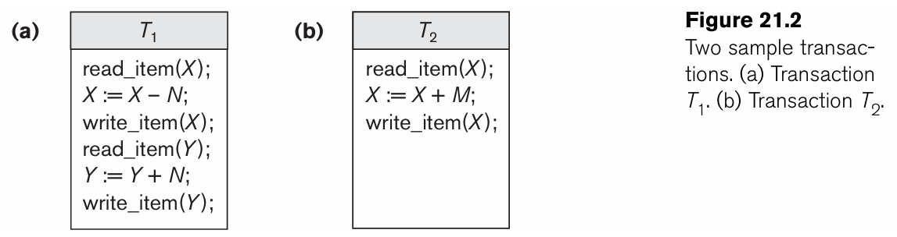
Characterizing Schedules based on Serializability
Schedules that are always considered to be correct when concurrent transactions are executing. Such schedules are known as serializable schedules
Suppose that two users—for example, two airline reservations agents—submit to the DBMS transactions T1 and T2 at approximately the same time.
If no interleaving of operations is permitted, there are only two possible outcomes:
1. Execute all the operations of transaction T1 (in sequence) followed by all the operations of transaction T2 (in sequence).
2.Execute all the operations of transaction T2(in sequence) followed by all the operations of transaction T1(in sequence).
Slide 17- <number>

Slide 40
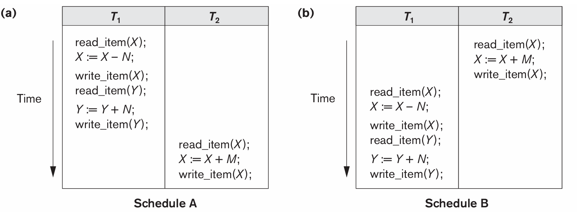
Characterizing Schedules based on Serializability
These two schedules—called serial schedules
Slide 17- <number>

Slide 41
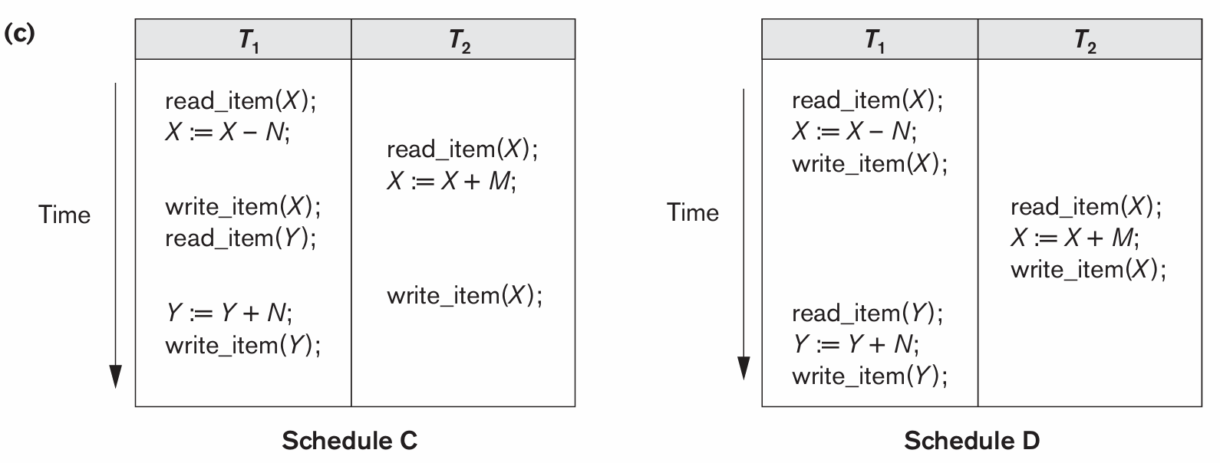
Characterizing Schedules based on Serializability
If interleaving of operations is allowed, there will be many possible orders in which the system can execute the individual operations of the transactions. Two possible schedules are
Slide 17- <number>

Slide 42
Characterizing Schedules based on Serializability
The concept of serializability of schedules is used to identify which schedules are correct when transaction executions have interleaving of their operations in the schedules.
Formally, a schedule S is serial if, for every transaction T participating in the schedule, all the operations of T are executed consecutively in the schedule; otherwise, the schedule is called nonserial.
The problem with serial schedules is that they limit concurrency by prohibiting interleaving of operations.
Slide 17- <number>

Slide 43
5 Characterizing Schedules based on Serializability
Serial schedule:
  A schedule S is serial if, for every transaction T participating in the schedule, all the operations of T are executed consecutively in the schedule.
    Otherwise, the schedule is called nonserial schedule.
Serializable schedule:
  A schedule S is serializable if it is equivalent to some serial schedule of the same n transactions.
Slide 17- <number>

Slide 44
Characterizing Schedules based on Serializability
Result equivalent:
  Two schedules are called result equivalent if they produce the same final state of the database.
Conflict equivalent:
  Two schedules are said to be conflict equivalent if the order of any two conflicting operations is the same in both schedules.
Conflict serializable:
  A schedule S is said to be conflict serializable if it is conflict equivalent to some serial schedule S’.
Slide 17- <number>

Slide 45
Characterizing Schedules based on Serializability (3)
Being serializable is not the same as being serial
Being serializable implies that the schedule is a correct schedule.
  It will leave the database in a consistent state.
  The interleaving is appropriate and will result in a state as if the transactions were serially executed, yet will achieve efficiency due to concurrent execution.
Slide 17- <number>

Slide 46
Characterizing Schedules based on Serializability (4)
Serializability is hard to check.
  Interleaving of operations occurs in an operating system through some scheduler
  Difficult to determine beforehand how the operations in a schedule will be interleaved.
Slide 17- <number>

Slide 47
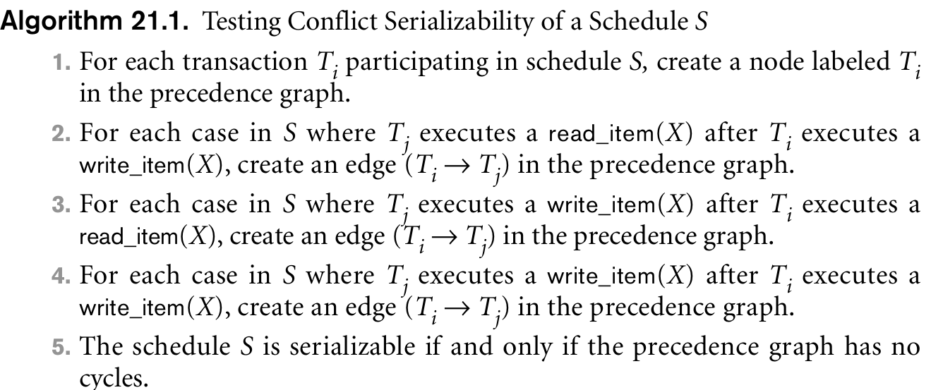
Testing for Conflict Serializability of a Schedule
Slide 17- <number>

Slide 48
If there is a cycle in the precedence graph, schedule S is not (conflict) serializable; if there is no cycle, S is serializable.
A cycle in a directed graph is a sequence of edges C = ((Tj → Tk), (Tk → Tp), ..., (Ti → Tj)) with the property that the starting node of each edge—except the first edge—is the same as the ending node of the previous edge, and the starting node of the first edge is the same as the ending node of the last edge (the sequence starts and ends at the same node).
Slide 17- <number>

Slide 49
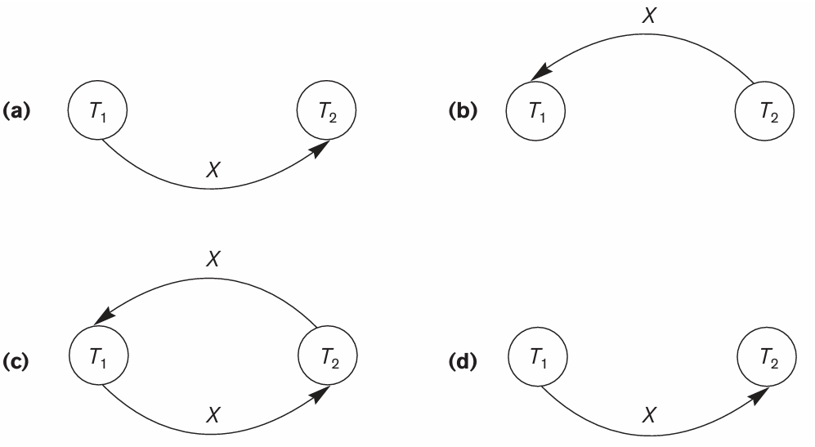
Precedency graph for previous example in slide number 40 and 41
(a) Precedence graph for serial schedule A. (b) Precedence graph for serial schedule B. (c) Precedence graph for schedule C (not serializable). (d) Precedence graph for schedule D (serializable, equivalent to schedule A).
Slide 17- <number>

Slide 50
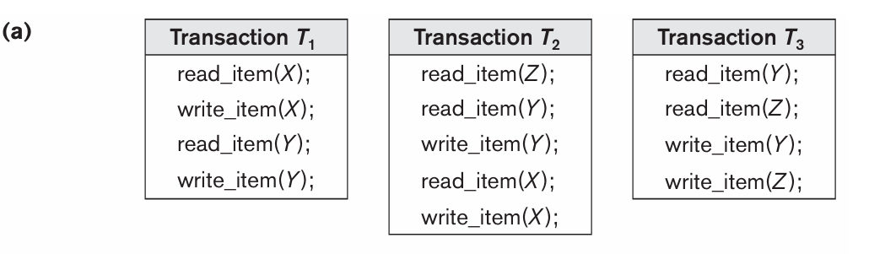
Check whether the following transactions are serializable are not
Slide 17- <number>

Slide 51
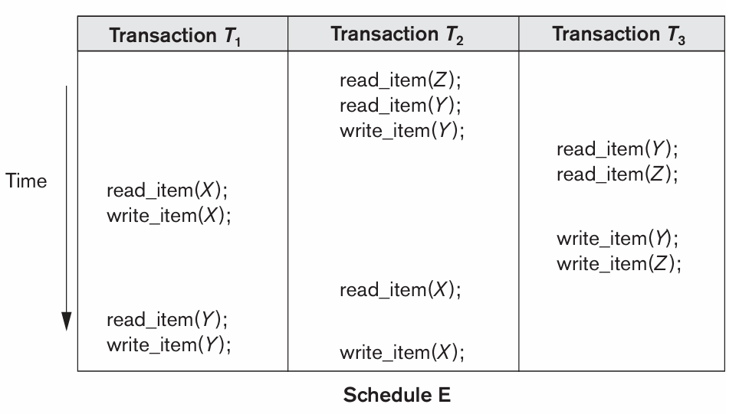
Two schedules E and F for these transactions are
Slide 17- <number>

Slide 52
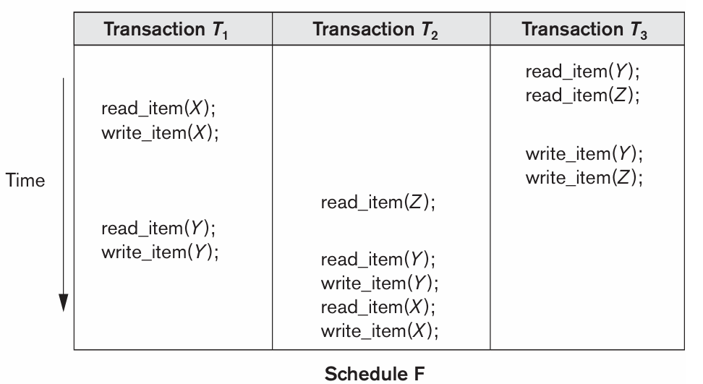
Slide 17- <number>

Slide 53

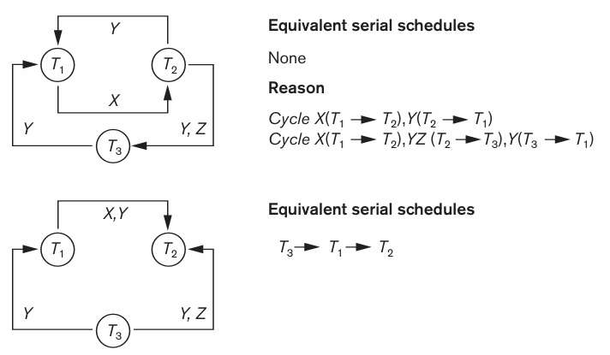
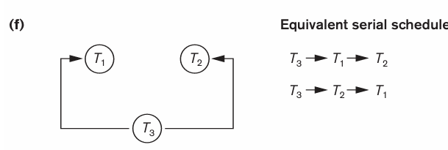
Slide 17- <number>

Slide 54
Characterizing Schedules based on Serializability (5)
Practical approach:
Come up with methods (protocols) to ensure serializability.
It’s not possible to determine when a schedule begins and when it ends.
  Hence, we reduce the problem of checking the whole schedule to checking only a committed project of the schedule (i.e. operations from only the committed transactions.)
Current approach used in most DBMSs:
  Use of locks with two phase locking
Slide 17- <number>

Slide 55
Characterizing Schedules based on Serializability (6)
View equivalence:
  A less restrictive definition of equivalence of schedules
View serializability:
  Definition of serializability based on view equivalence.
  A schedule is view serializable if it is view equivalent to a serial schedule.
Slide 17- <number>

Slide 56
Characterizing Schedules based on Serializability (7)
Two schedules are said to be view equivalent if the following three conditions hold:
  The same set of transactions participates in S and S’, and S and S’ include the same operations of those transactions.
  For any operation Ri(X) of Ti in S, if the value of X read by the operation has been written by an operation Wj(X) of Tj (or if it is the original value of X before the schedule started), the same condition must hold for the value of X read by operation Ri(X) of Ti in S’.
  If the operation Wk(Y) of Tk is the last operation to write item Y in S, then Wk(Y) of Tk must also be the last operation to write item Y in S’.
Slide 17- <number>

Slide 57
Characterizing Schedules based on Serializability (8)
The premise behind view equivalence:
  As long as each read operation of a transaction reads the result of the same write operation in both schedules, the write operations of each transaction must produce the same results.
  “The view”: the read operations are said to see the same view in both schedules.
Slide 17- <number>

Slide 58
Characterizing Schedules based on Serializability (9)
Relationship between view and conflict equivalence:
  The two are same under constrained write assumption which assumes that if T writes X, it is constrained by the value of X it read; i.e., new X = f(old X)
  Conflict serializability is stricter than view serializability. With unconstrained write (or blind write), a schedule that is view serializable is not necessarily conflict serializable.
  Any conflict serializable schedule is also view serializable, but not vice versa.
Slide 17- <number>

Slide 59
Characterizing Schedules based on Serializability (10)
Relationship between view and conflict equivalence (cont):
  Consider the following schedule of three transactions
    T1: r1(X), w1(X); T2: w2(X); and T3: w3(X):
  Schedule Sa: r1(X); w2(X); w1(X); w3(X); c1; c2; c3;
In Sa, the operations w2(X) and w3(X) are blind writes, since T1 and T3 do not read the value of X.
  Sa is view serializable, since it is view equivalent to the serial schedule T1, T2, T3.
  However, Sa is not conflict serializable, since it is not conflict equivalent to any serial schedule.
Slide 17- <number>

Slide 60
Characterizing Schedules based on Serializability (11)
Testing for conflict serializability: Algorithm 17.1:
  Looks at only read_Item (X) and write_Item (X) operations
  Constructs a precedence graph (serialization graph) - a graph with directed edges
  An edge is created from Ti to Tj if one of the operations in Ti appears before a conflicting operation in Tj
  The schedule is serializable if and only if the precedence graph has no cycles.
Slide 17- <number>

Slide 61
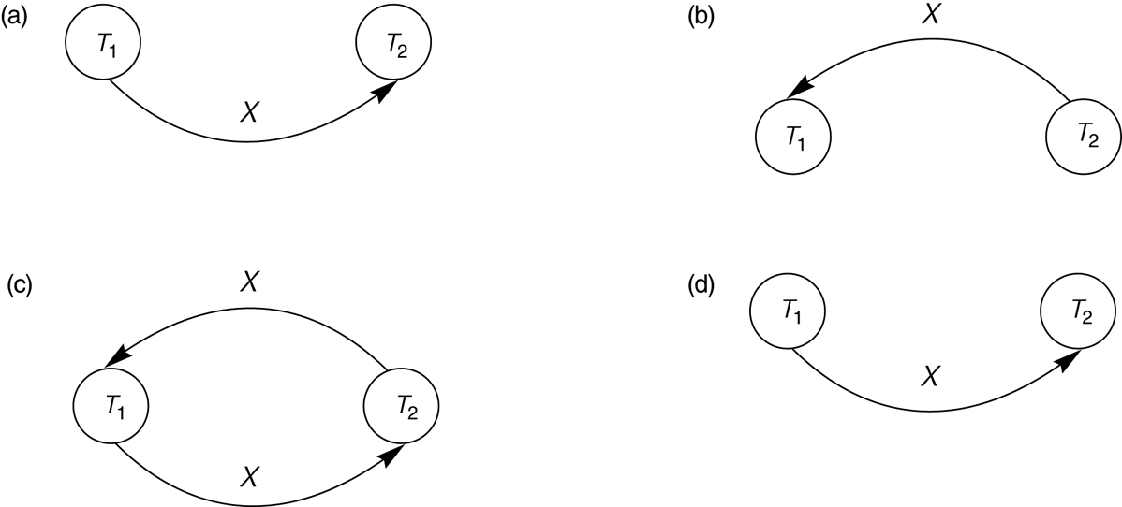
Constructing the Precedence Graphs
FIGURE 17.7 Constructing the precedence graphs for schedules A and D from Figure 17.5 to test for conflict serializability.
  (a) Precedence graph for serial schedule A.
  (b) Precedence graph for serial schedule B.
  (c) Precedence graph for schedule C (not serializable).
  (d) Precedence graph for schedule D (serializable, equivalent to schedule A).
Slide 17- <number>

Slide 62
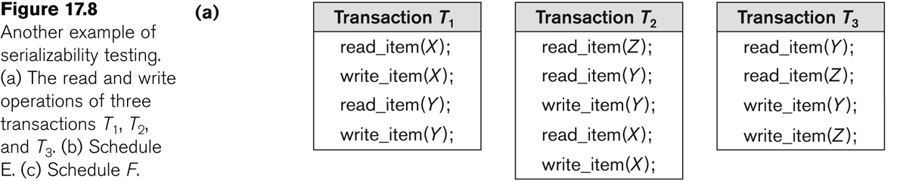
Another example of serializability Testing
Slide 17- <number>

Slide 63
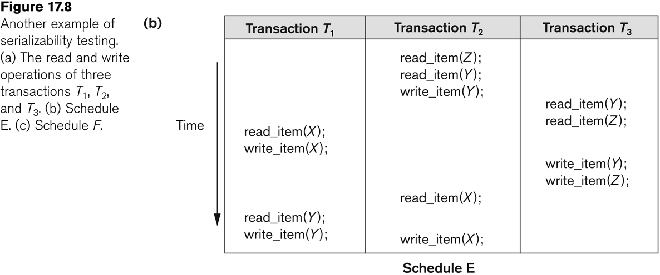
Another Example of Serializability Testing
Slide 17- <number>

Slide 64
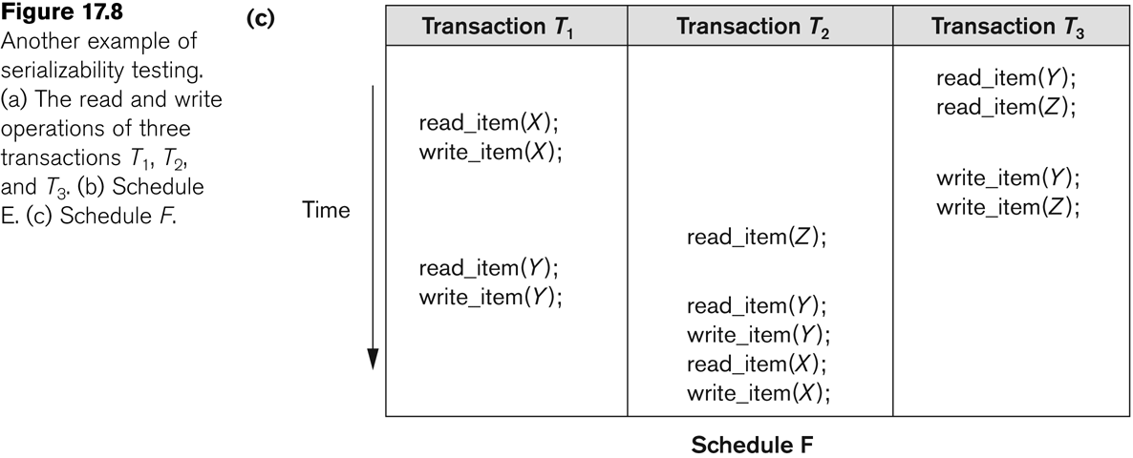
Another Example of Serializability Testing
Slide 17- <number>

Slide 65
Characterizing Schedules based on Serializability (14)
Other Types of Equivalence of Schedules
Under special semantic constraints, schedules that are otherwise not conflict serializable may work correctly.
  Using commutative operations of addition and subtraction (which can be done in any order) certain non-serializable transactions may work correctly
Slide 17- <number>

Slide 66
Characterizing Schedules based on Serializability (15)
Other Types of Equivalence of Schedules (contd.)
Example: bank credit / debit transactions on a given item are separable and commutative.
  Consider the following schedule S for the two transactions:
  Sh : r1(X); w1(X); r2(Y); w2(Y); r1(Y); w1(Y); r2(X); w2(X);
  Using conflict serializability, it is not serializable.
  However, if it came from a (read,update, write) sequence as follows:
    r1(X); X := X – 10; w1(X); r2(Y); Y := Y – 20;r1(Y);
    Y := Y + 10; w1(Y); r2(X); X := X + 20; (X);
  Sequence explanation: debit, debit, credit, credit.
  It is a correct schedule for the given semantics
Slide 17- <number>

